Slide 1
MTS/LDH Assay results and attachment experiment attempts
(Numerical values of assay results are attached in the spreadsheet)
Notes:
Microparticle and cell counting with digital microfluidic compact disk using standard CD drive

Slide 2
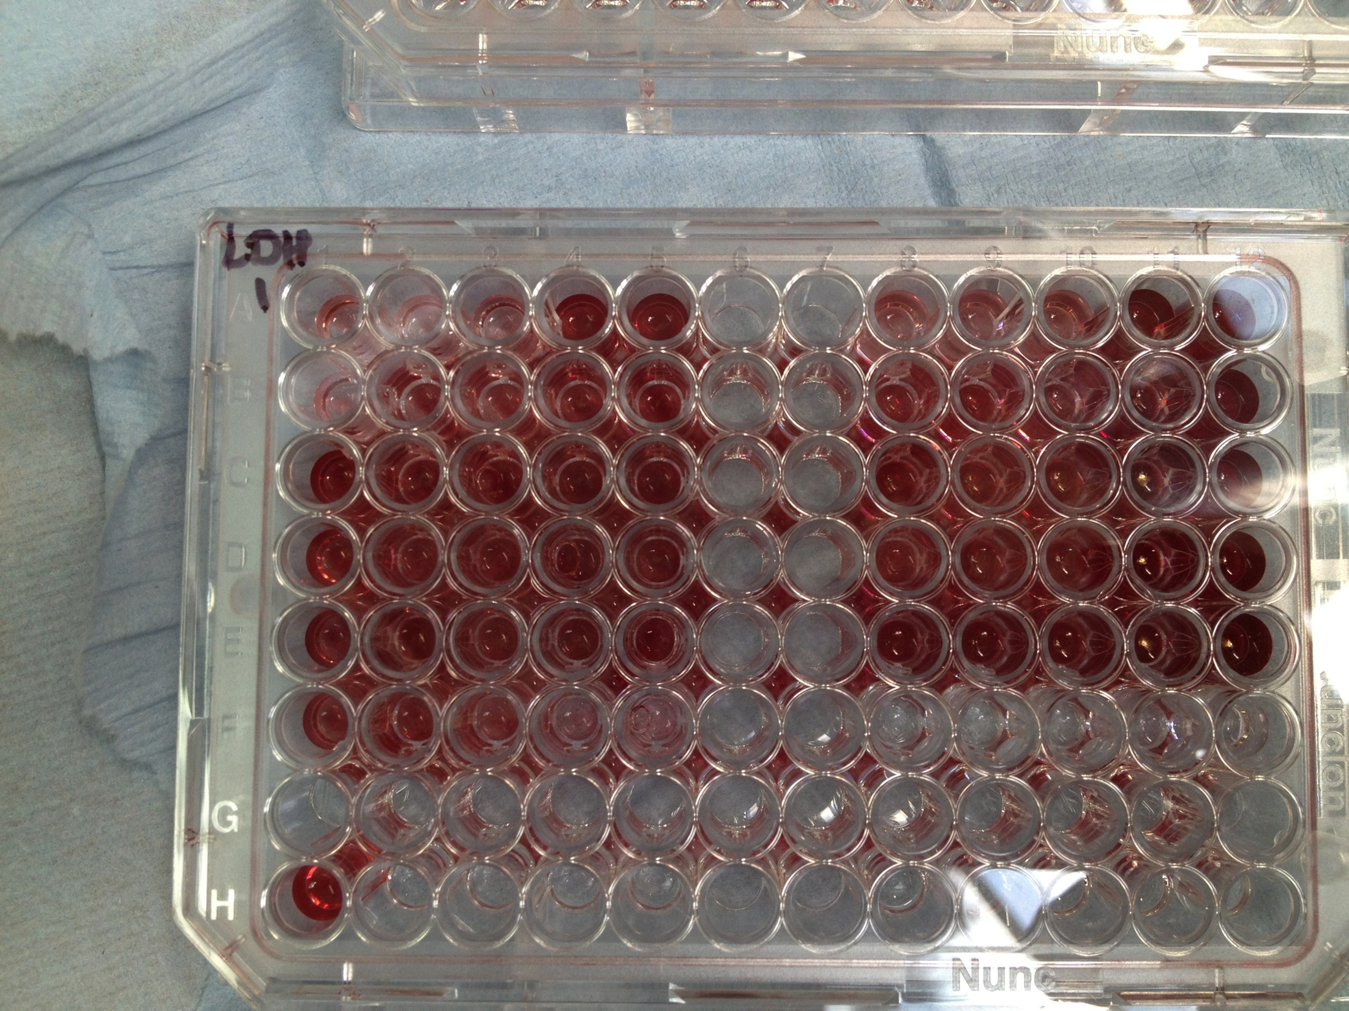
Fibroblast 3T3 cells were cultured and plated in six 96-well plates. 3 plates were for MTS, and 3 - for LDH assays. These 6 plates were incubated in 37C overnight to ensure the cells are attached and have settled down.
Samples 1,2,3,4 were incubated in media for 24 hours in a shaker based on the proportion of 0.1g dry weight of sample per 1 ml of media.
Next, the assays were conducted according to the protocol attached.
Sample plate. One of the 3 LDH assay plates, after lysis and after reading the absorbance off of it.

Slide 3
MTS Results
Viability
Viability | 100% extract
S1 | 141.789941
S2 | 143.1236674
S3 | 66.72267983
S4 | 71.47252378
Tripton X | 36.86520857
Viability | 50% extract
S1 | 240.1549933
S2 | 221.101191
S3 | 107.1993907
S4 | 127.7797594
Tripton X | 41.81511816
Note: If viability is over 80%, then sample is considered non-toxic.
Cells incubated with S1 and S2 show viability at 100% and 50% extracts. S3 and S4 cells are not viable at 100% extract, however they show viability at 50% extract incubation for S4. This could be due to carbon taking up all the nutrients from media at 100% extract, but when the extract is diluted to 50% with media, there is enough nutrients in media, and cells incubated with S4 sample stay viable.

Slide 4
LDH Results
Cytotoxicity
Cytotoxicity | 100% extract
S1 | 20.64306663
S2 | 44.6447987
S3 | 70.11975687
S4 | 85.44163145
TritonX | 78.93130248
Cytotoxicity | 50%
S1 | 22.5941265
S2 | 49.56612521
S3 | 69.07730871
S4 | 63.52781034
TritonX | 111.1561703
Note: If cytotoxicity is over 20%, then sample is generally considered cytotoxic.
Cells incubated with S1, although, close to the threshold value, but can be concluded non-toxic. However, cells incubated with other samples seem to show toxicity at 100% and 50% extracts.
While reading the absorbance by multiplate reader, the machine couldn’t obtain some of the readings due to high absorbance values. Although, the missing values were replaced with average of other wells’ readings, this could have contributed to the inaccuracies in final results of cytotoxicity.

Slide 5
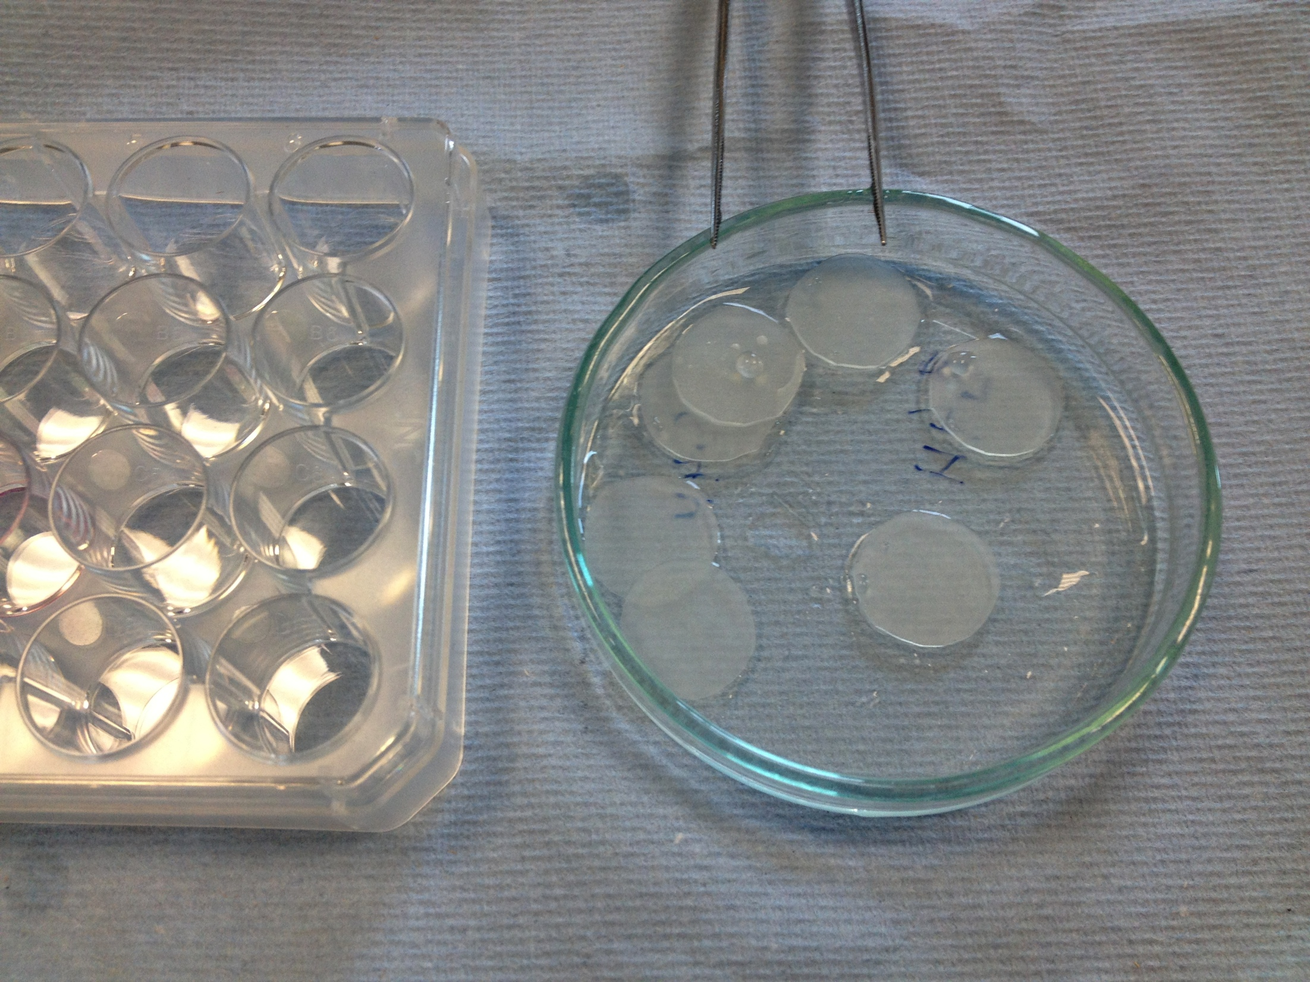
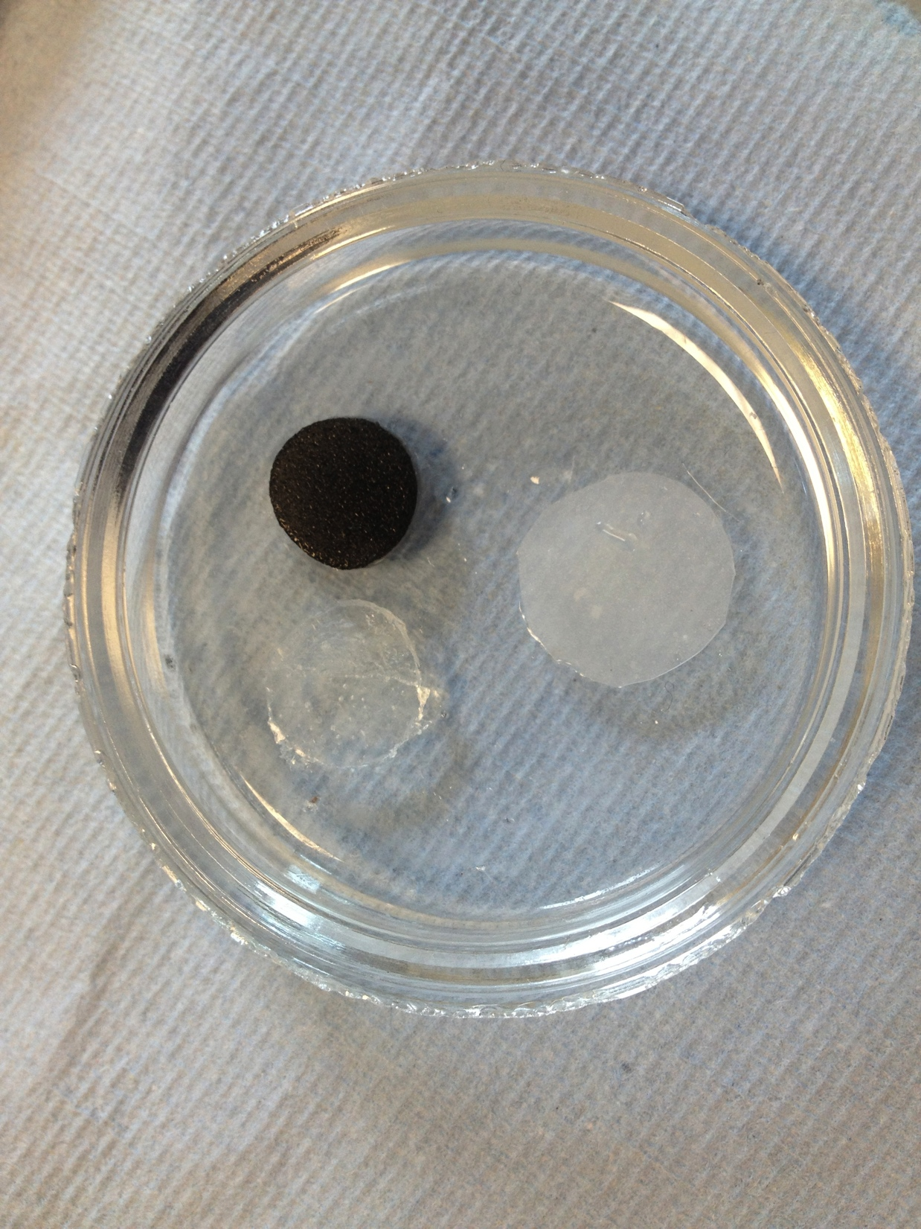
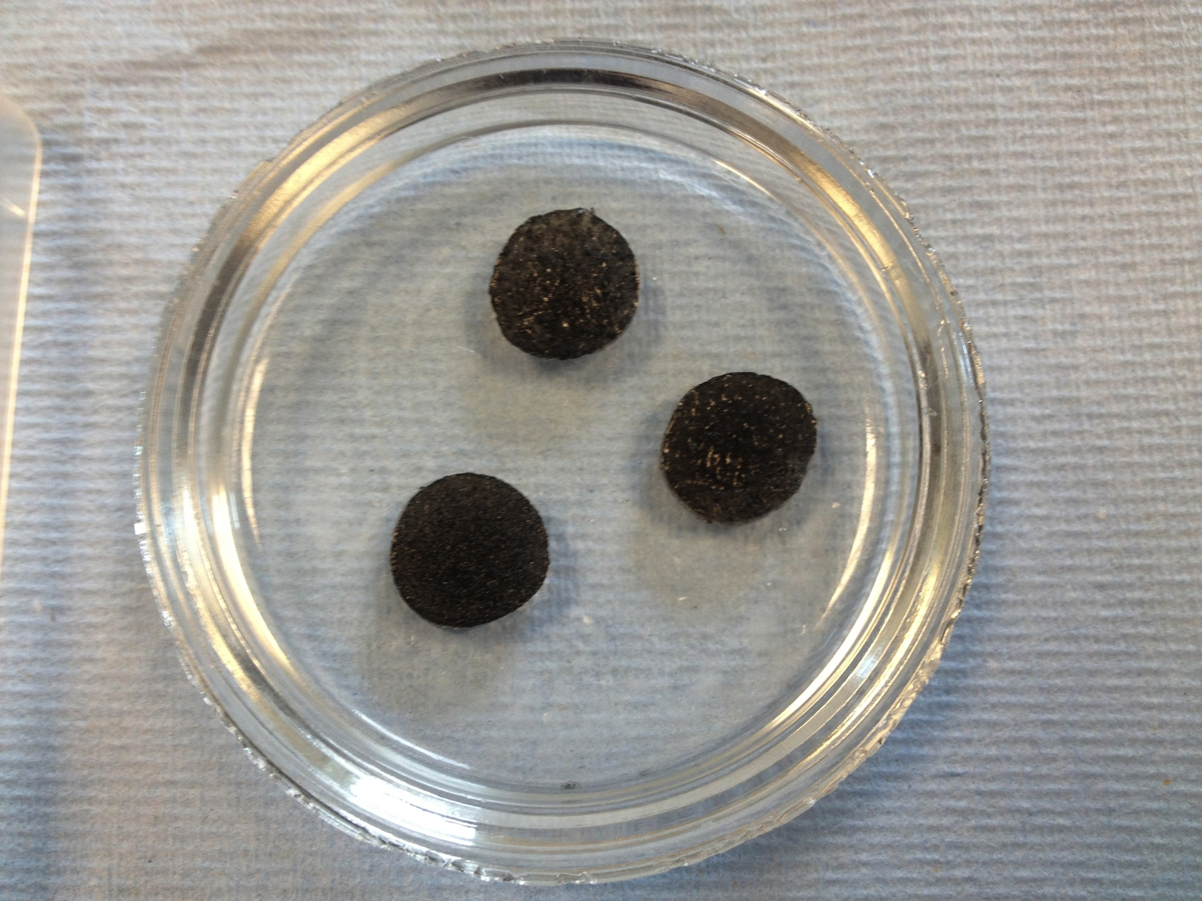
Attachment/Disattachment experiment
1. Silicone circles were cut in order to fully cover the bottom surface of 12-well plate. Substrate samples were cut in smaller diameter, in order to fully be emerged in the media.
Sample 2
Silicone samples
Sample 1, Sample 2 and silicone

Slide 6
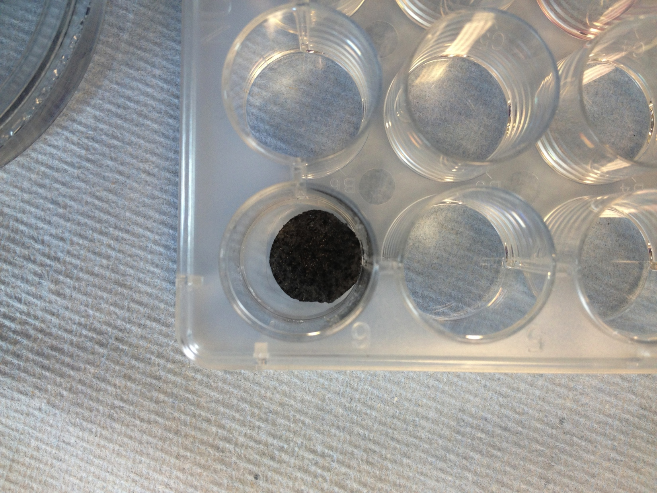
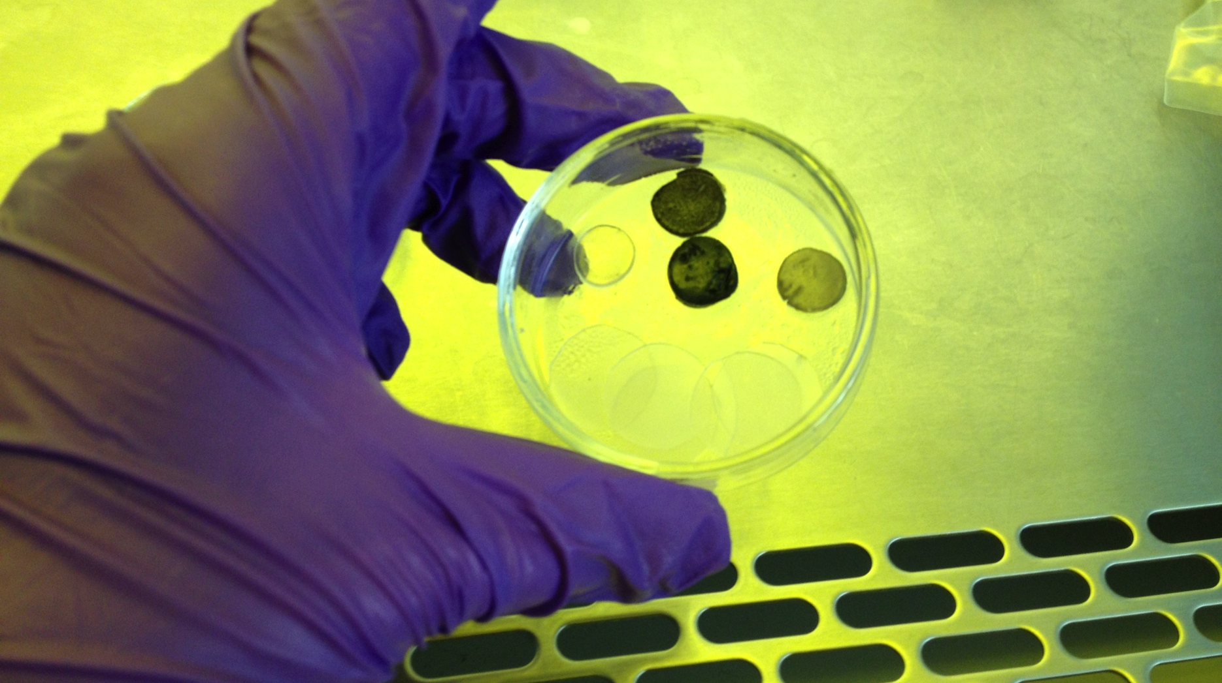
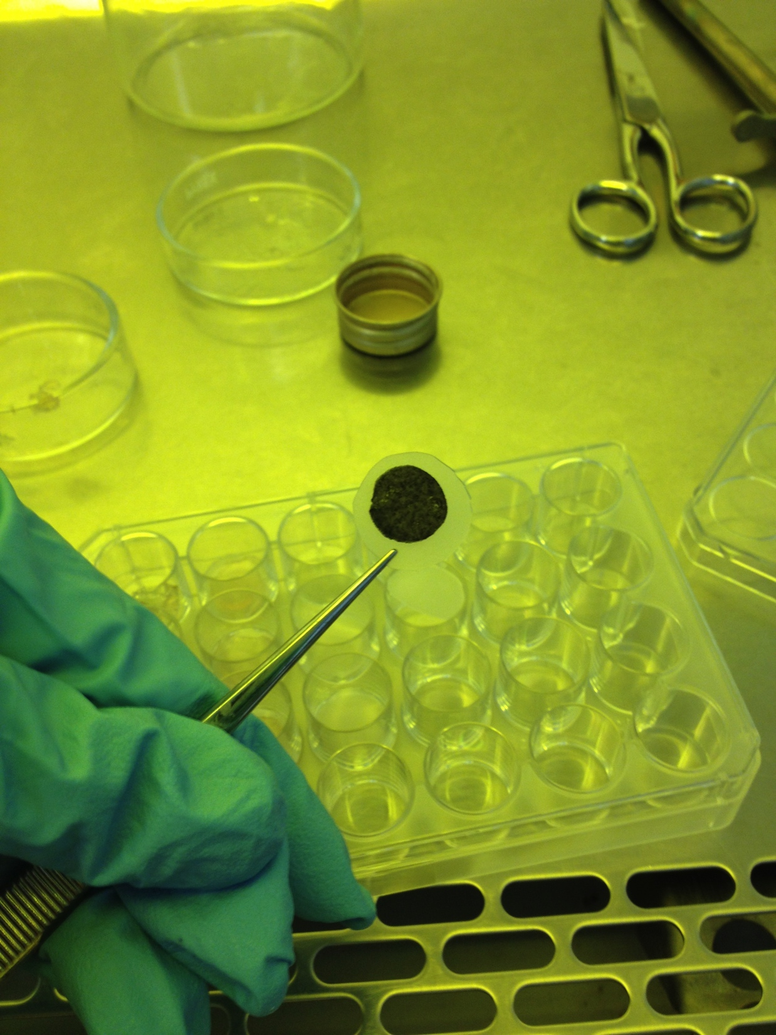
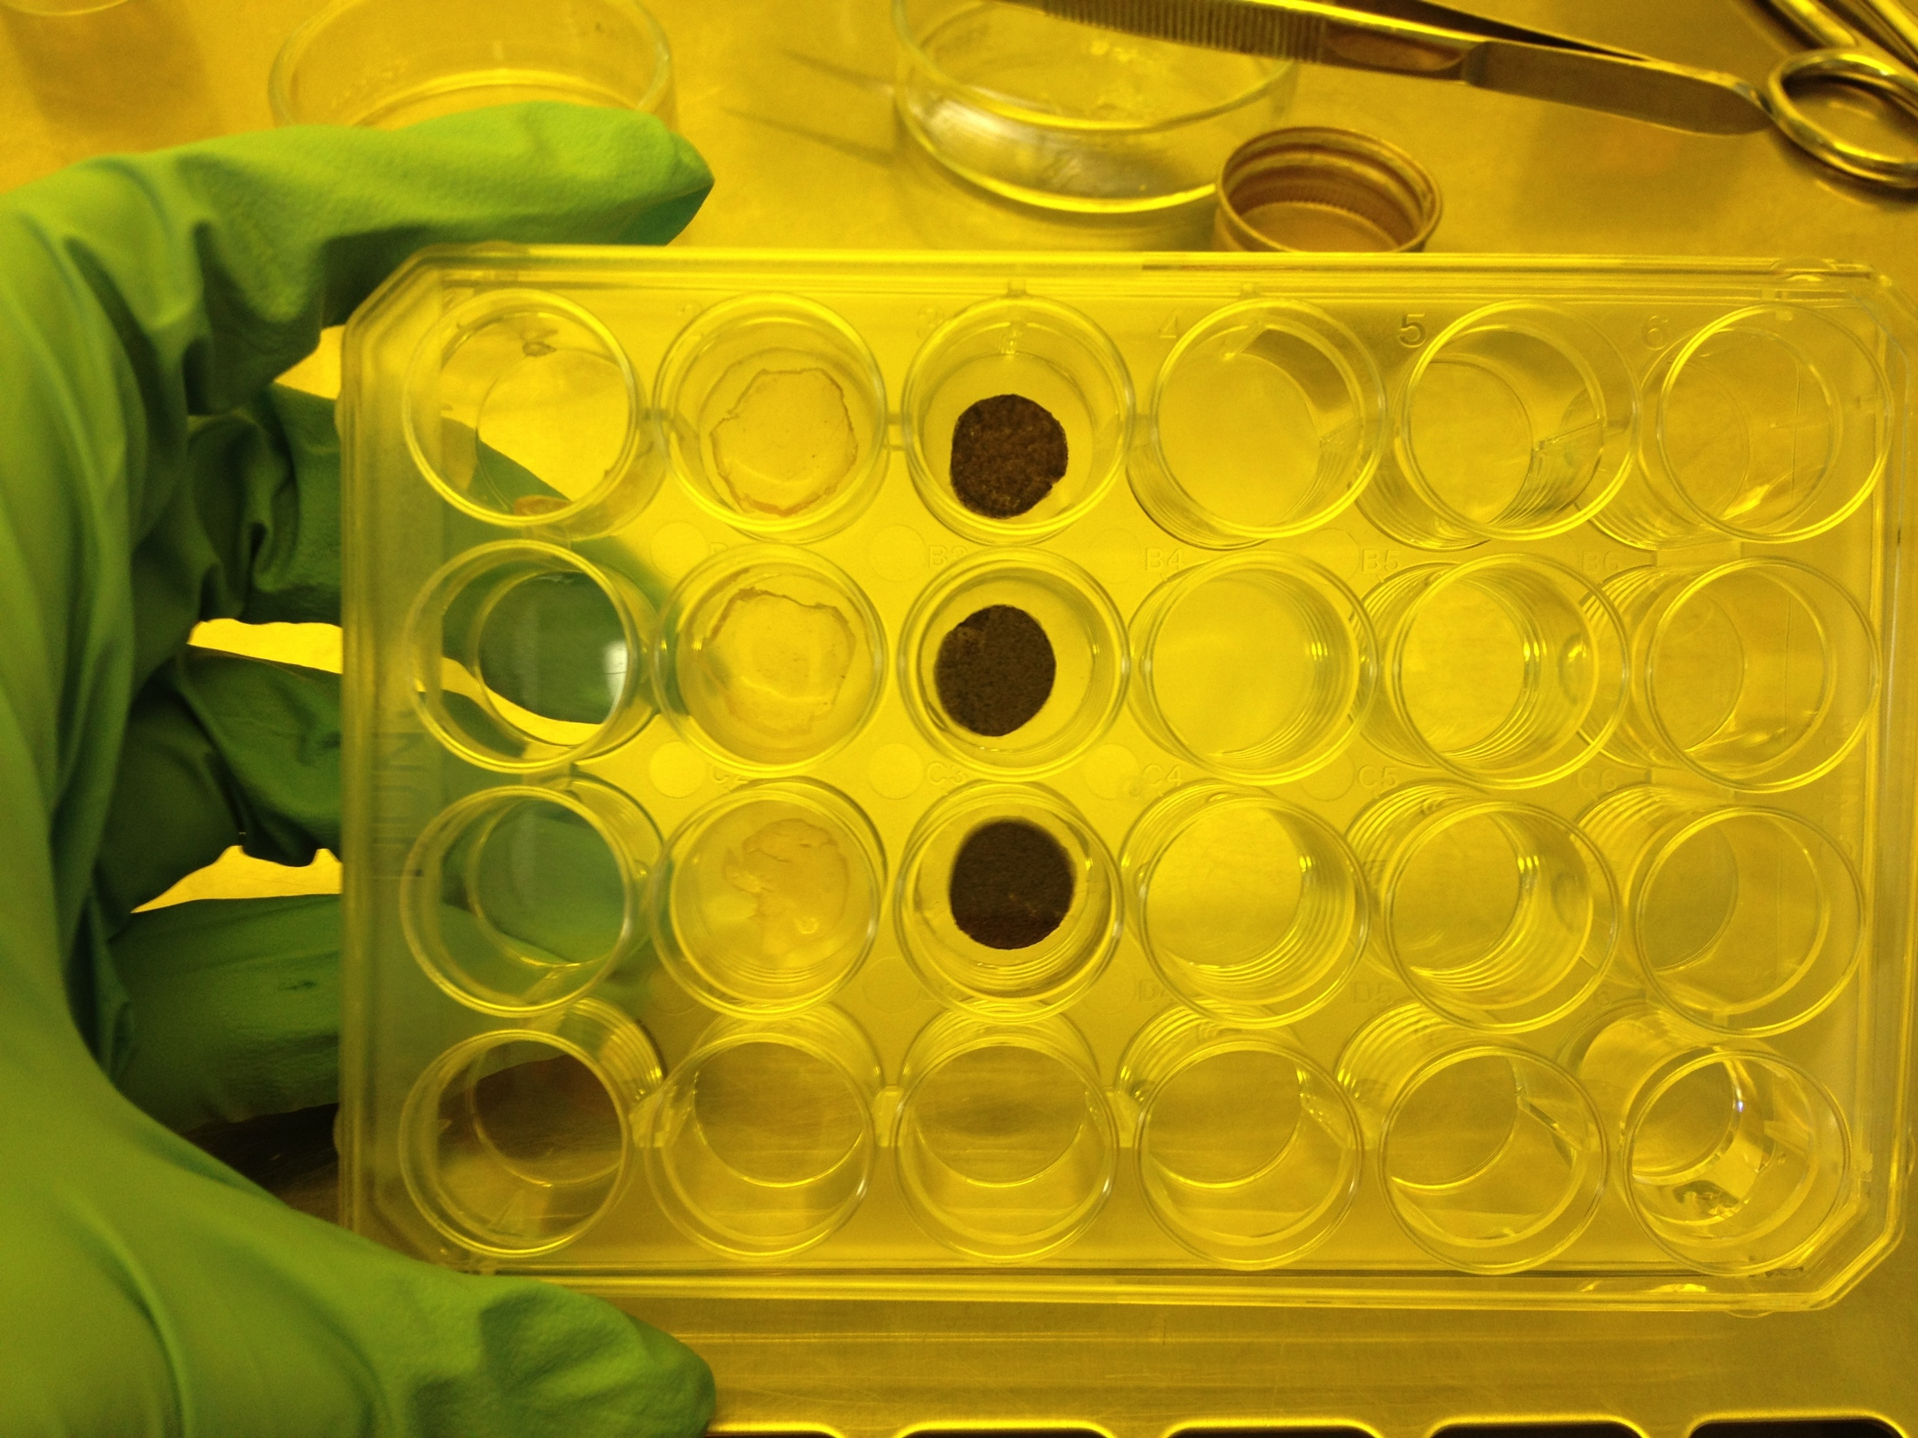
2. Silicone circles were placed on the bottom of the well and confirmed to be aligned well.
Sample 1, 2, 3, 4 and silicone
Sample 2 on top, and silicone circle underneath
3. Samples were placed on top.

Slide 7
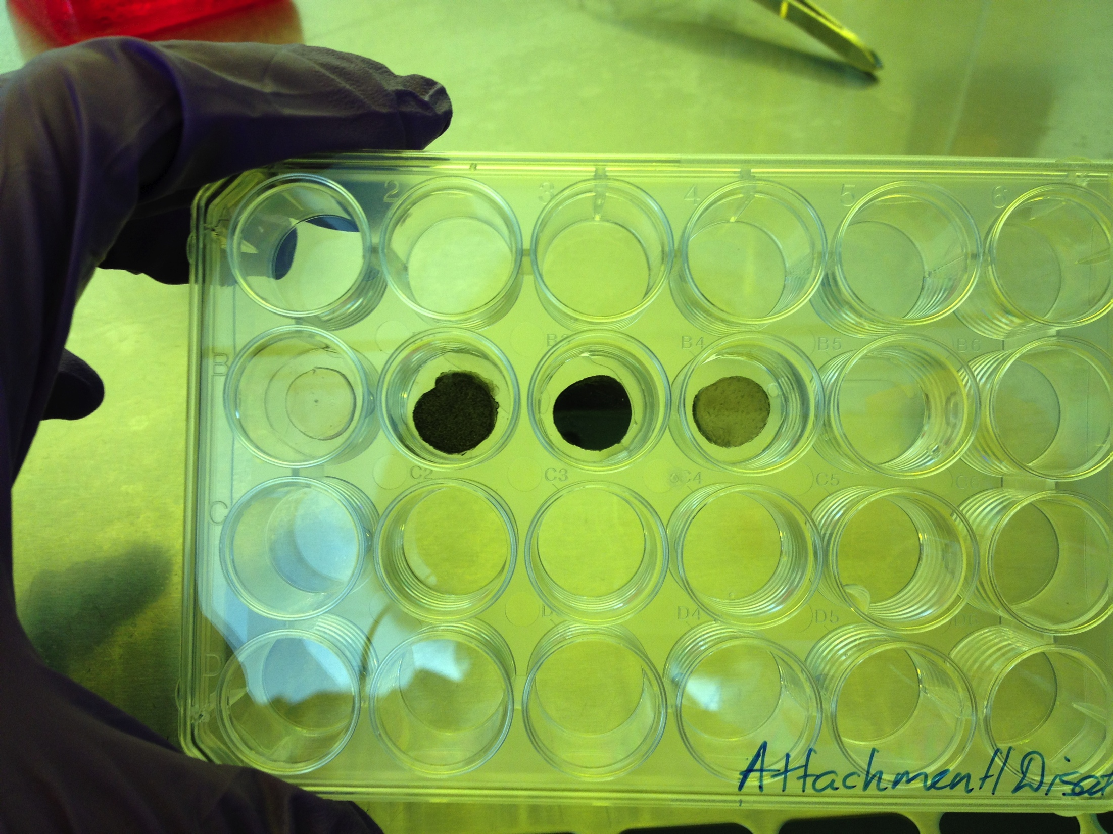
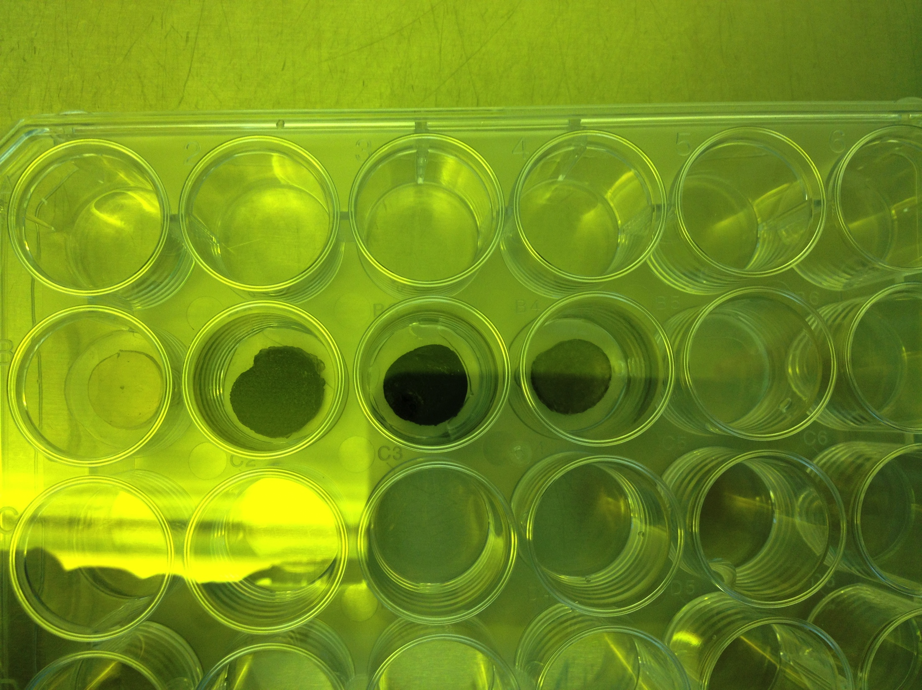
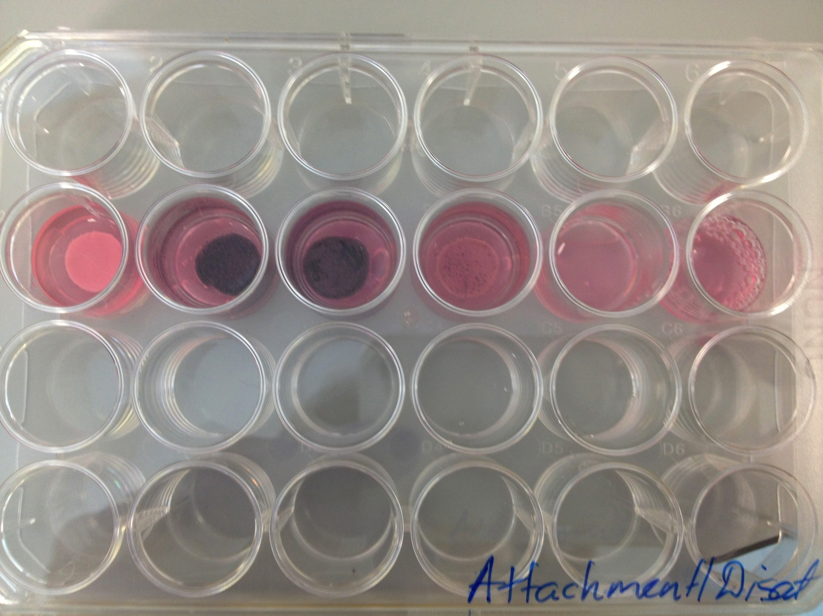
4. Samples were placed in the following order from left to right: S1, S2, S3, S4, bare Silicone, cells
5. 3T3 cells with concentration of 2x10^6 cells/mL were introduced into each well.
6. The plate was incubated at 37C for 4 hours in the first attempt, and for 3 hours in the next.
7. After incubation media was taken from each well. This was supposed to be done to ensure that attachment had occurred. However, even though no cells were found in the media from Samples 1-4, there were minimal cells found from the well with silicone. At this point it was clear, that the positive control somehow lets the cells penetrate through to the bottom, or attaches cells itself.
8. The plate was incubated in cryogel bath brought to -20C for 30 minutes.
9. Afterwards, media was collected and cells counted. Cell number obtained from each well was S1=2*10^4, S2=10^4, S3=3*10^4, S4=5*10^4, S5=4*10^4. No cells were observed from the negative control well(simple cells). These values are too small to be considerate accurate. Silicone well ideally need to give off total amount of cells that were introduced in the well.
The same experiment can be carried out but with the replacement of 12-well plate by non-sticky plates.

